Slide 1
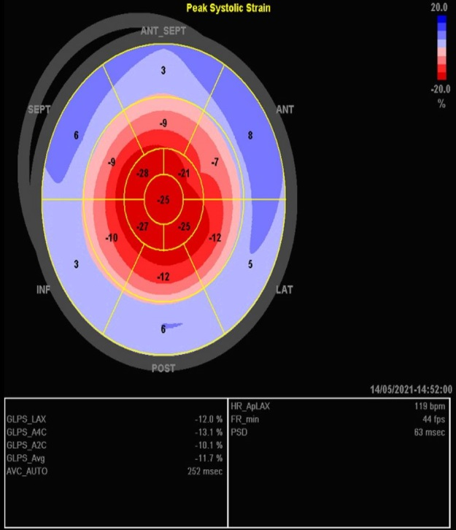
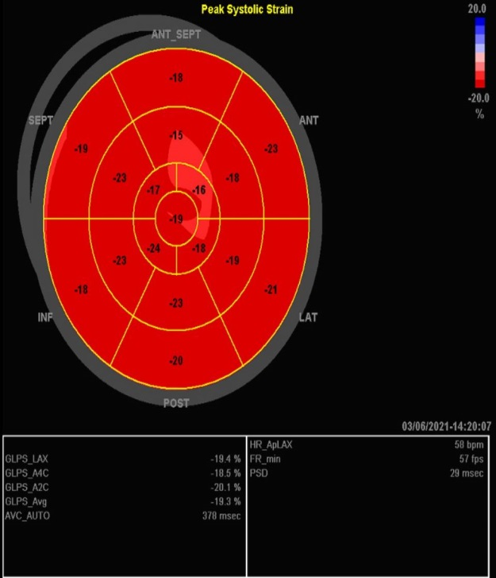
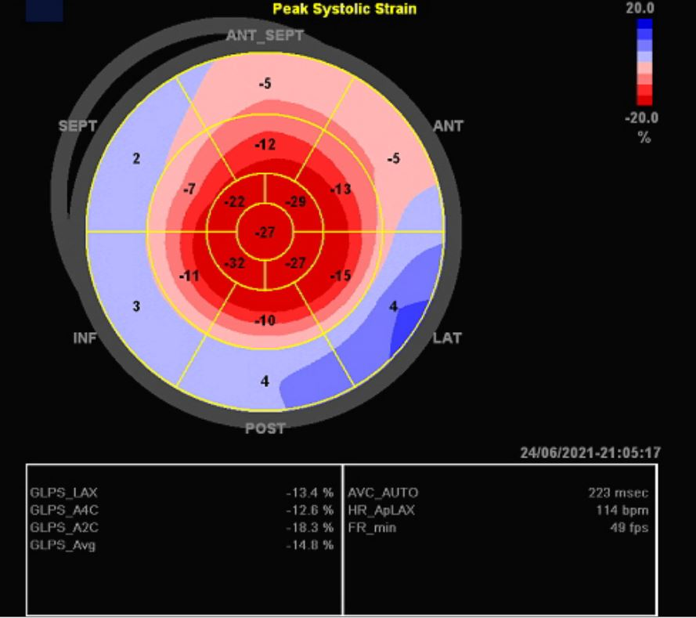
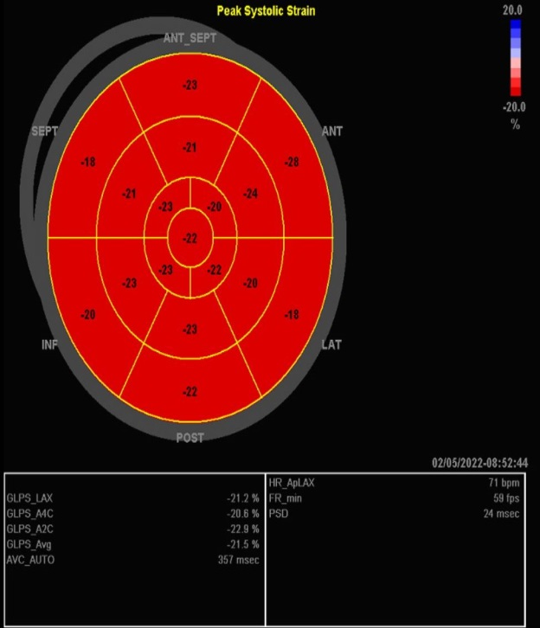
Supplement (2): (a) GLS during the first episode of the disease showing -11.2 (b) GLS after improvement of symptoms showing complete resolution of the abnormalities and average GLS of -19.3
(c)GLS of -14.3 during the second attack .(d) GLS of -21.5 after improvement of the symptoms showing complete resolution.
(a)
(b)
(c)
(d)

