Slide 1
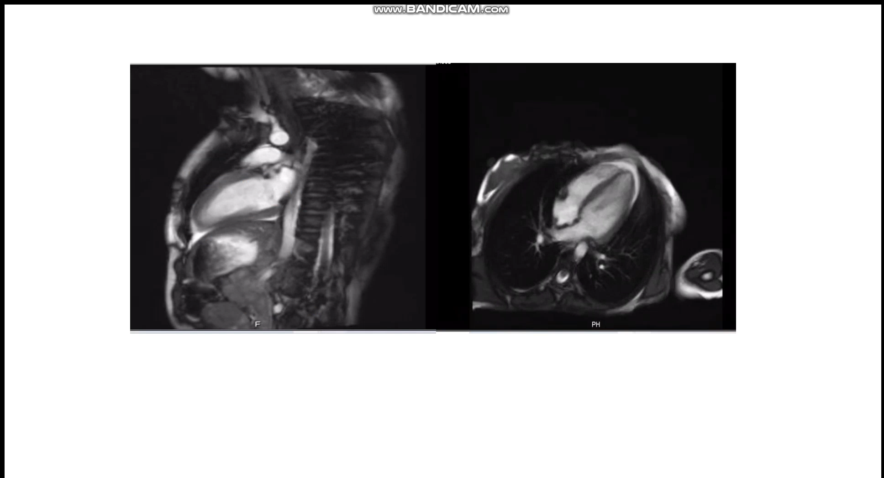
(a)
(b)
supplement (3): (a)cine image showing two chambers view showing apical hyperkinesia and mid basal segment akinesia. (b) cine image of apical and three chambers view showing apical hyperkinesia and basal mid segment hypokinesia.

