Slide 1
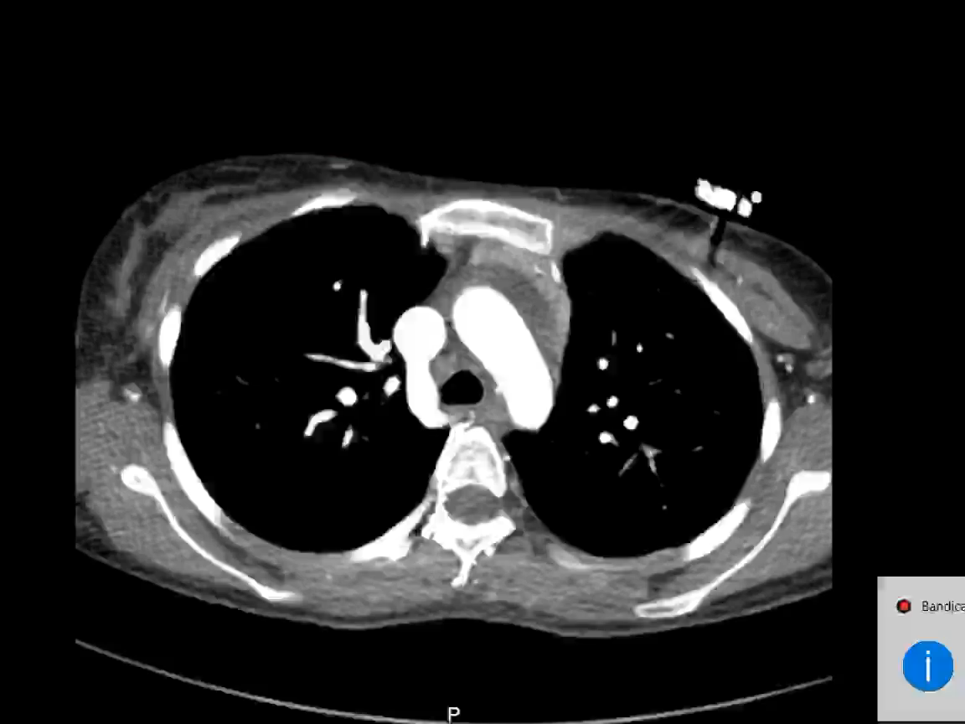
supplement (4): CT coronary showing normal coronary arteries.

